Slide 1
Analysis of
ALGORITHMS
DR. DIBYENDU B. SEAL
Assistant Professor (W.B.E.S.)
A.P.C. Roy Govt. College, Siliguri

Slide 2
Introduction
Data Structures: A systematic way of organizing and accessing data.
-- No single data structure works well for ALL purposes.
Input
Algorithm
Output
An algorithm is a step-by-step procedure for solving a problem in a finite amount of time.
Program = algorithms + data structures

Slide 3
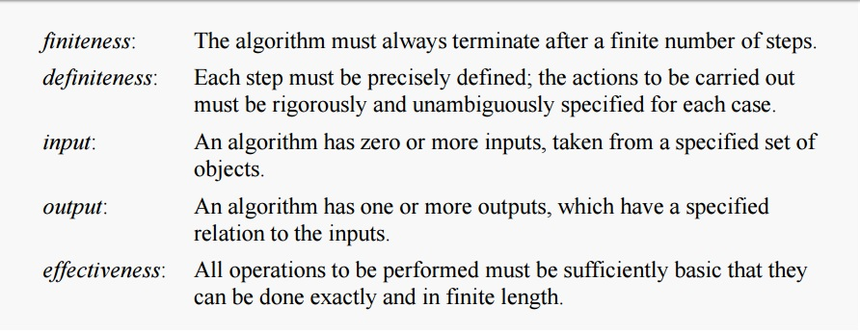
Properties of a good Algorithm

Slide 4
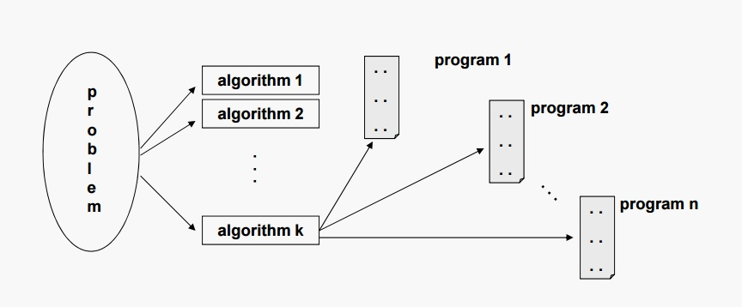
Properties of a good Algorithm
For each problem or class of problems, there may be many different algorithms.
For each algorithm, there may be many different implementations (programs).

Slide 5
Analysis of Algorithms
Analysis invloves –
Tracing the algorithm for logical correctness, implementing the algorithm and testing it on some data.
Checking the algorithm for simplicity
However, the simplest way of solving a problem is sometimes not the best one, specially when, the simplest approach involves the use of too much computer time or space!!

Slide 6
Analysis of Algorithms (Contd..)
Thus, it is important to analyze the time and space requirements of an algorithm to see if it is within acceptable limits.
Example:
An algorithm that sums the values in an array can be expected to require more time for an array of size 10000 than for one of size 100.

Slide 7
Analysis of Algorithms
Estimate the running time – Time Complexity T(n)
Estimate the memory space required – Space Complexity S(n)
Both depends on the input size n

Slide 8
Time Complexity

Slide 9
Running Time
The running time of an algorithm typically grows with the input size.
Average case time is often difficult to determine.
We focus on the worst case running time.
  Easier to analyze
  Crucial to applications such as games, finance and robotics

Slide 10
Case Study
Suppose a machine that performs a million floating-point operations per second (10⁶ FLOPS), then how long an algorithm will run for an input of size n=50?
  1) If the algorithm requires n² such operations:

Slide 11
Case Study
Suppose a machine that performs a million floating-point operations per second (10⁶ FLOPS), then how long an algorithm will run for an input of size n=50?
  1) If the algorithm requires n² such operations:
    0.0025 second

Slide 12
Case Study
Suppose a machine that performs a million floating-point operations per second (10⁶ FLOPS), then how long an algorithm will run for an input of size n=50?
  1) If the algorithm requires n² such operations:
    0.0025 second
  2) If the algorithm requires 2^{n} such operations:
    A) Takes a similar amount of time (t < 1 sec)
    B) Takes a little bit longer time (1 sec < t < 1 year)
    C) Takes a much longer time (1 year < t)
Can you guess?

Slide 13
Case Study
Suppose a machine that performs a million floating-point operations per second (10⁶ FLOPS), then how long an algorithm will run for an input of size n=50?
  1) If the algorithm requires n² such operations:
    0.0025 second
  2) If the algorithm requires 2^{n} such operations:
    over 35 years!

Slide 14
Definition of Time?

Slide 15
Definition of Time
# of seconds (machine, implementation dependent).
# lines of code executed.
# of times a specific operation is performed (e.g., addition).

Slide 16
Theoretical analysis of time efficiency
Time efficiency is analyzed by determining the number of repetitions of the basic operation as a function of input size
Basic operation: the operation that contributes most towards the running time of the algorithm.
Input size
T(n) ≈ c_{op}C(n)
Running time
Number of times the basic operation is executed
Execution time
for one basic operation

Slide 17
Case Study
Problem | Input size measure | Basic operation
Search for key in a list of n items
Multiply two matrices of floating point numbers
Compute a^{n}
Graph problem
Notes:
regarding a^{n} point out that the input size measure is more properly measured by
number of bits:
b= ⌊log₂ n⌋ + 1
Graph problems are mentioned here just to give me an opportunity to discuss
them in general. Typically this will depend on graph representation and the specific
problem.

Slide 18
Case Study
Problem | Input size measure | Basic operation
Search for key in a list of n items | Number of items in the list: n | Key comparison
Multiply two matrices of floating point numbers
Compute a^{n}
Graph problem

Slide 19
Case Study
Problem | Input size measure | Basic operation
Search for key in a list of n items | Number of items in the list: n | Key comparison
Multiply two matrices of floating point numbers | Dimensions of matrices | Floating point multiplication
Compute a^{n}
Graph problem

Slide 20
Case Study
Problem | Input size measure | Basic operation
Search for key in a list of n items | Number of items in the list: n | Key comparison
Multiply two matrices of floating point numbers | Dimensions of matrices | Floating point multiplication
Compute a^{n} | n | Floating point multiplication
Graph problem

Slide 21
Case Study
Problem | Input size measure | Basic operation
Search for key in a list of n items | Number of items in the list: n | Key comparison
Multiply two matrices of floating point numbers | Dimensions of matrices | Floating point multiplication
Compute a^{n} | n | Floating point multiplication
Graph problem | #vertices and/or edges | Visiting a vertex or traversing an edge

Slide 22
Best-case, Average-case, Worst-case
Worst case: W(n) – “maximum” over inputs of size n
  Provides an upper bound on running time
  An absolute guarantee that the algorithm would not run longer, no matter what the inputs are
Best case: B(n) – “minimum” over inputs of size n
  Provides a lower bound on running time
  Input is the one for which the algorithm runs the fastest
Lower bound ≤ Running time ≤ Upper bound

Slide 23
Best-case, Average-case, Worst-case (Contd..)
Average case: A(n) – “average” over inputs of size n
  Provides a prediction about the running time
  Assumes that the input is random
  Under some assumption about the probability distribution of all possible inputs of size n, calculates the weighted sum of expected C(n) (numbers of basic operation repetitions) over all possible inputs of size n.

Slide 24
Exercise: Sequential search
Problem: Given a list of n elements and a search key K, find an element equal to K, if any.
Algorithm: Scan the list and compare its successive elements with K until either a matching element is found (successful search) or the list is exhausted (unsuccessful search)
Worst case -
Best case -
Average case -
n comparisons
1 comparison
(1+2+3+…n)/n = (n+1)/2

Slide 25
Some simple exercises:
x++;
… frequency of operation = 1
for(i=0;i<n;i++)
  x++;
… frequency of operation = n
for(i=0;i<n;i++)
  for(j=0;j<n;j++)
  x++;
  … frequency of operation = n²

Slide 26
Growth of functions
The rate of change of execution time T(n) with the change in the number of inputs is called growth of function.
T(n) can be approximately equal to:
  n^{n}
  n!
  2^{n}
  n³
  n²
  nlog₂ n
  n
  log₂ n
  1
Exponential /factorial functions
Linear/polynomial functions
Logarithmic function
Constant

Slide 27
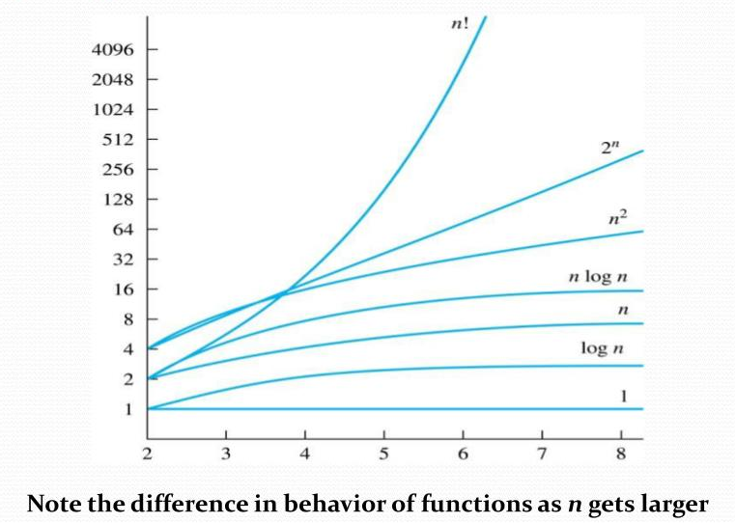
Comparison - for large n

Slide 28
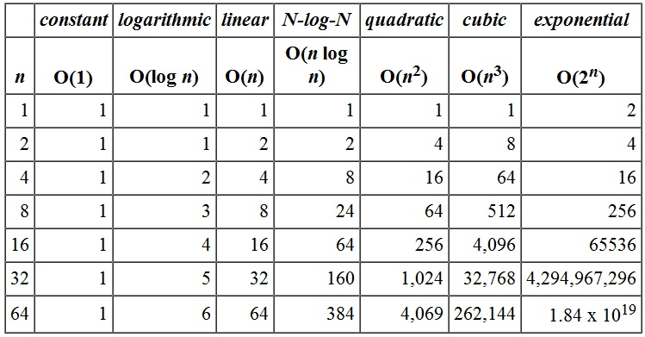
Comparison - for large n (Contd..)

Slide 29
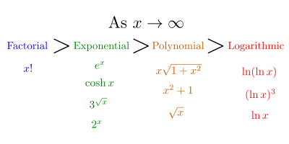
Comparison - for large n (Contd..)

Slide 30
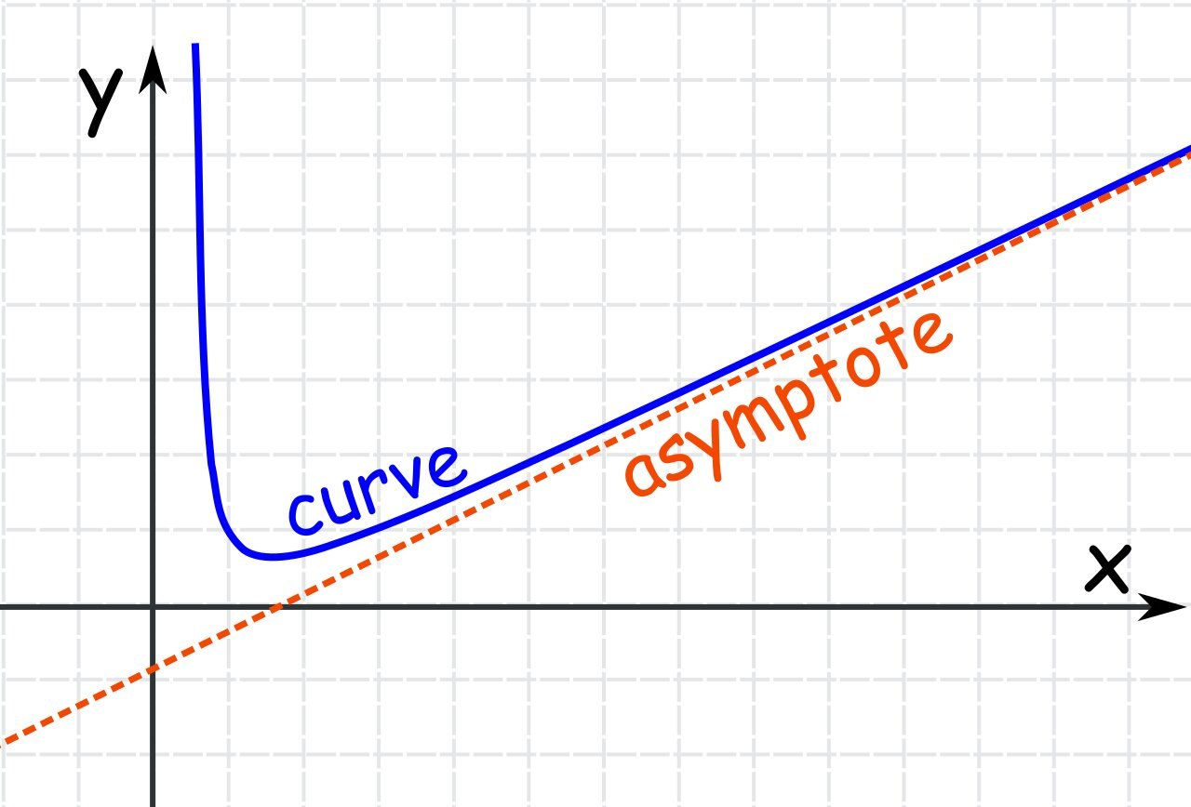
Asymptotic Analysis
An asymptote of a curve is a line such that the distance between the curve and the line approaches zero as one or both of the x or y coordinates tends to infinity.
Asymptotic or asymptotically close to are treated synonymous in time complexity terminology of computer science.
To compare two algorithms with running times f(n) and g(n) within a limit, that is, asymptotically!
A rough measure that characterizes how fast each function grows.
Remember! we evaluate the performance of an algorithm in terms of input size (we don't measure the actual running time)
Hint: use rate of growth

Slide 31
Example
Consider the example of buying elephants and goldfish:
Cost: cost_of_elephants + cost_of_goldfish
Cost ~ cost_of_elephants (approximation)
The low order terms in a function are relatively insignificant for large n
n⁴ + 100n² + 10n + 50 ~ n⁴
  i.e., we say that n⁴ + 100n² + 10n + 50 and n⁴ have the same rate of growth

Slide 32
Asymptotic Notations
O (Big-Oh/Big O) notation: asymptotic “less than”:
  f(n)=O(g(n)) implies: f(n) “≤” g(n)
Ω (Big Omega) notation: asymptotic “greater than”:
  f(n)= Ω (g(n)) implies: f(n) “≥” g(n)
Θ (Big Theta) notation: asymptotic “equality”:
  f(n)= Θ (g(n)) implies: f(n) “=” g(n)

Slide 33
Big-O Notation Examples
We say f_{A}(n) = 30n+8 is order n, or O (n)
It is, at most, roughly proportional to n.
f_{B}(n) = n²+1 is order n², or O(n²).
It is, at most, roughly proportional to n².
In general, any O(n²) function is faster- growing than any O(n) function.

Slide 34
Visualizing Orders of Growth
On a graph, as
you go to the
right, a faster
growing
function
eventually
becomes
larger...
f_{A}(n)=30n+8
Value of function →
f_{B}(n)=n²+1
Increasing n →

Slide 35
More Examples …
n⁴ + 100n² + 10n + 50 is O(n⁴)
10n³ + 2n² is O(n³)
n³ - n² is O(n³)
constants
  10 is O(1)
  1273 is O(1)

Slide 36
Asymptotic Notations – “Big Oh”
=> f(n)=O(g(n))

Slide 37
Example
But, how?
f(n) = n³ – 20n² + 100n
=> f(n)=O(n³)
Explanation:
We need to find the values of c & n₀ for which the condition
f(n) ≤ c.g(n) holds.
Now, ∀ n ≥ 0,
n³ – 20n² + 100n ≤ n³ + 20n³ + 100n³ = 121n³
=> c=121 and n₀=0

Slide 38
More Examples …
f(n) = 6n⁴ – 2n³ + 5
=> f(n)=O(n⁴)
Explanation:
∀ n ≥ 1,
6n⁴ – 2n³ + 5 ≤ 6n⁴ + 2n⁴ + 5n⁴ = 13n⁴
=> c=13 and n₀=1

Slide 39
Exercise
Prove that T(n) = n³ + 20n + 1 is O(n³).
  Hint:
  T(n) = O(n³) if T(n) ≤ c.n³ for some n ≥ n_{0.} Find c & n₀
  Solution:
∀ n ≥ n₀ = 1 and c ≥ 22 (= 1 + 20 + 1),
n³ + 20n + 1 ≤ 22n³

Slide 40
Exercise
Prove that T(n) = 3n² + 4n - 2 is O(n²).
  Solution:
  We need to find c and n₀ such that 3n² + 4n - 2 ≤ c.n² for all n ≥ n_{0.}
Dividing both sides by n²,
3 + 4/n – 2/ n² ≤ c for all n ≥ n_{0.}
If we choose n=n₀ = 1, then we need a value of c such that:
3 + 4 – 2 ≤ c
Putting c=6, we get
3n² + 4n - 2 ≤ 6n² for all n ≥ n_{0.}
=> c=6 and n₀=1

Slide 41
Asymptotic Notations – “Big Omega”
=> f(n)=Ω(g(n))

Slide 42
Example
How?
f(n) = 3n + 2
=> f(n) = Ω(n)
Explanation:
This time, we need to find the values of c & n₀ for which the condition
f(n) ≥ c.g(n) holds.
Now, ∀ n ≥ 0,
3n + 2 > 3n
=> c=3 and n₀=0

Slide 43
More Examples …
f(n) = 10n² + 2n + 2
=> f(n)= Ω(n²)
Explanation:
∀ n ≥ 0,
10n² + 2n + 2 > 10n²
=> c=10 and n₀=0

Slide 44
Exercise
Prove that T(n) = 3.2^{n} + n² is Ω(2^{n}).
  Hint:
  T(n) = Ω(2^{n}) if T(n) ≥ c.2^{n} for some n ≥ n_{0.} Find c & n₀
  Solution:
∀ n ≥ n₀ = 0 and c =3,
3.2^{n} + n² ≥ 3.2^{n}

Slide 45
Relationship between Big O & Big Ω
f(n) = Ω(g(n)) iff
g(n) = O(f(n))

Slide 46
Asymptotic Notations – “Big Theta”
Θ(g(n)) is the set of functions with the same order of growth as g(n)
=> f(n)= Θ(g(n))

Slide 47
Example
f(n) = 3n + 2
=> f(n) = Θ(n)
Explanation:
Here, we need to find the values of c₁, c₂ & n₀ for which the condition c₁.g(n) ≤ f(n) ≤ c₂.g(n) holds.
Now, ∀ n ≥ 0,
3n + 2 > 3n ............................ (Eqn. 1)
and, ∀ n ≥ 2,
3n + 2 ≤ 4n ............................ (Eqn. 2)
Combining equations (1) & (2),
We get, 3n ≤ 3n + 2 ≤ 4n ∀ n ≥ 2
=> c₁=3, c₂=4 and n₀=2
How?

Slide 48
Exercise
Prove that T(n) = 10n² + 2n + 2 is Θ(n²).
  Hint:
  T(n) = Θ(n²) if c₁.n² ≤ T(n) ≤ c₂.n² for some n ≥ n_{0.} Find c₁, c₂ & n₀
  Solution:
∀ n ≥ n₀ = 2, c₁ = 10 and c₂ = 12,
10n² ≤ 10n² + 2n + 2 ≤ 12n²

Slide 49
Some Important Properties
f(n) = O(f(n))
f(n) = Ω(f(n))
f(n) = Θ(f(n))
f(n) = O(g(n)) and
g(n) = O(h(n)) ⇒ f(n) = O(h(n))
f(n) = Ω(g(n)) and
g(n) = Ω(h(n)) ⇒ f(n) = Ω(h(n))
f(n) = Θ(g(n)) and
g(n) = Θ(h(n)) ⇒ f(n) = Θ(h(n))
Reflexivity
Transitivity

Slide 50
More Properties …
f(n) = Θ(g(n)) ⇐⇒ g(n) = Θ(f(n))
f(n) = O(g(n)) ⇐⇒ g(n) = Ω(f(n))
f(n) = O(g(n)) and f(n) = Ω(g(n))
⇒ f(n) = Θ(g(n))
Symmetry
Transpose
Symmetry
Theorem

Slide 51
Dig your brains..!!
Express the following using Big-O Notation :-
statement;
… O(1)
for(i=0;i<n;i++)
  statement;
  … O(n)
for(i=0;i<n;i++)
  for(j=0;j<n;j++)
  statement;
  … O(n²)

Slide 52
Dig your brains..!! Deeper!!
Express the following using Big-O Notation :-
h=1;
while(h <= n)
{
  statement;
h=2*h;
}
  … 1+ log₂ n = O(log₂ n)
for(i=1;i<=n;i++)
  for(j=1;j<=i;j++)
  statement;
  … 1+2+3+…+n = n(n+1)/2 = O(n²)

Slide 53
Okay! Last one, I promise ☺
Express the following using Big-O Notation :-
h=n;
for(i=0; h>1; i++, h=h/2)
  {
  for(j=0;j<n;j++)
  statement;
  }
  … Outer loop - log₂ n times
  Inner loop – n times
  => O(n.log₂ n)

Slide 54
Space Complexity

Slide 55
Space Overhead
The total storage space can be determined at two different times:-
  Compile time
    - Determine the storage size for each variable only
  Run time
    - Determine space required for storing the program (Code Space)
    - Determine space required for constants, variables and dynamic memory allocation (if any). (Data Space)
    - Determine memory required to save addresses while making nested recursive function calls. (Stack Space)

Slide 56
Thank You… ☺

